Slide 1


Contact Center Performance 📈
Gaurav Rai
📧 ur.gaurav26@gmail.com
www.linkedin.com/in/gaurav-rai26
https://github.com/gaurav-rai26

Slide 2



Objective
To analyze customer interactions and performance metrics across channels (Web, Chat, Phone and Email), queries, sentiments, and SLA.
Identify performance trends and areas for improvement.
Tools Used: Excel (Dashboard)
MySQL Microsoft PowerPoint

Slide 3
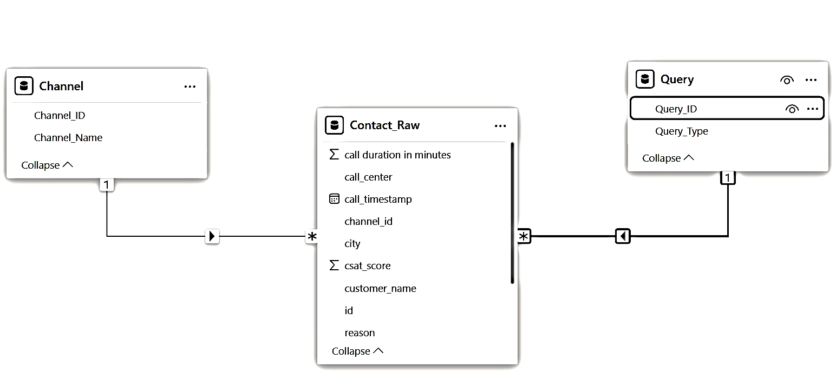
Dataset Overview & Relationships
Lookup Table for Interaction Channel
Lookup Table for Interaction Reason (Query Type)
Main Interaction Data with 32941 rows

Slide 4
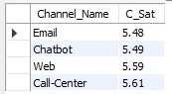
Channel-wise CSAT Scores
Using CTE
With MyCte as (select cn.Channel_Name, nullif(cr.csat_score, '') as csatfrom contact_raw cr left join channel cnon cr.channel_id = cn.Channel_ID)select Channel_Name, round(avg(csat),2) as C_Satfrom MyCtegroup by Channel_Nameorder by C_Sat;

Slide 5

% of calls resolved Within SLA
select q.query_type as Query_Type, (count(cr.id)/(select count(*) from contact_raw))*100 as Call_Percentage
from contact_raw cr left join query q
on cr.reason = q.Query_ID where response_time = 'Within SLA'
group by q.query_type;
Used LEFT JOIN for joining tables

Slide 6
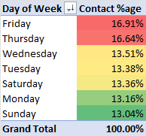
Contact Volume by Day of Week

Slide 7
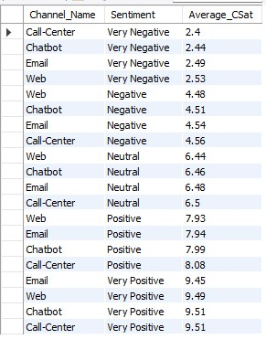
Channel-wise Sentiment Analysis with CSAT
select cn.Channel_Name as Channel_Name, cr.sentiment as Sentiment, round(avg(nullif(cr.csat_score, '')),2) as Average_CSat
from contact_raw cr left join query q
on cr.reason = q.Query_ID left join channel cn
on cr.channel_id = cn.Channel_ID
group by cn.Channel_Name, cr.sentiment
order by Average_CSat desc
Utilized NULLIF to replace Blank Values with NULL

Slide 8
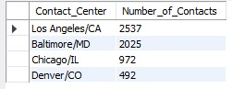
'Very Negative' Sentiment by Contact Center
select call_center as Contact_Center, count(id) as Number_of_Contacts
from contact_raw
where sentiment = 'Very Negative'
group by Contact_Center
order by Number_of_Contacts desc;

Slide 9
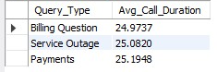
Average Call Duration by Query Type
ALTER TABLE contact_raw
CHANGE `call duration in minutes` call_duration_minutes INT; -- changed column name
select q.Query_Type as Query_Type, round(avg(cr.call_duration_minutes),2) as Avg_Call_Duration
from contact_raw cr left join query q
on cr.reason = q.Query_ID
group by Query_Type
order by Avg_Call_Duration;

Slide 10
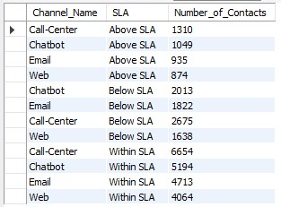
SLA Breakdown by Channel
select cn.Channel_Name, cr.response_time as SLA, count(*) as Number_of_Contactsfrom contact_raw cr left join channel cnon cr.channel_id = cn.Channel_IDgroup by cn.Channel_Name, cr.response_timeorder by cr.response_time;

Slide 11
Excel Dashboard

Slide 12
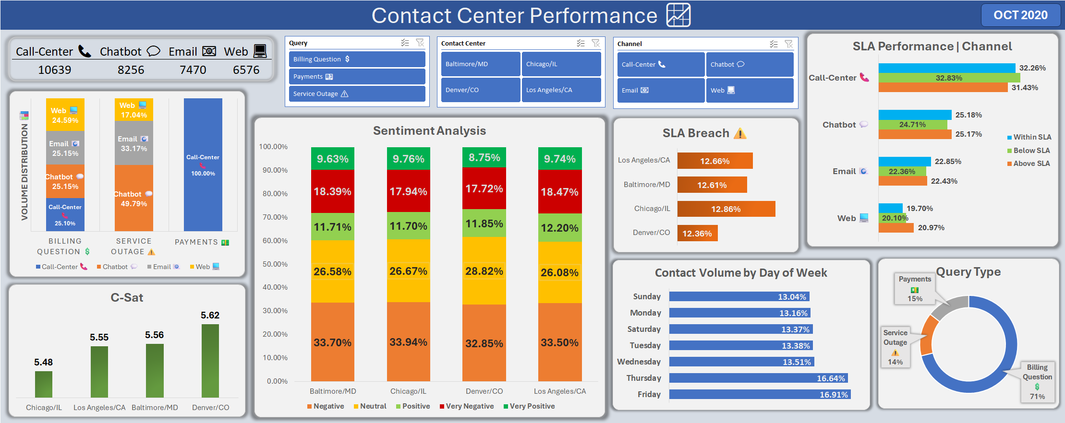

Slide 13
Key Insights & Recommendations
Denver, CO contact center scores highest CSAT (5.62) with lowest SLA Breach (12.36%) ⭐
Chicago, IL contact center has highest SLA Breach (12.86%)
For ‘Very Positive’ sentiment, Call & Chat perform best (CSAT: 9.51)
For ‘Very Negative’ sentiment, Email & Web outperform Call & Chat
Thursday (16.64%) and Friday (16.91%) are peak contact days – prepare more staffing 🧑‍🤝‍🧑
Los Angeles/CA contact center leads in Very Negative sentiment, followed by Baltimore/MD contact center – requires attention ⚠️
Payment queries take the longest (25.2 min), and are exclusively resolved via Call Center
Billing Questions account for 71% of all contacts – major focus area 🎯

Slide 14
Thank you
Looking forward to your feedback.

